Slide 1


Project Guide
Mr. Mahesh Shittlani
Project Guide
Mr. Bhanu Pratap Singh
Name | PRN
Narkhede Akash Gajanan | 230330920001
Shinde Vivek Rajendra | 230330920022
Nerkar Manoj Nagraj | 230330920006

Slide 2

E-COMMERCE WEB APPLICATION.

Slide 3
WHAT IS E-COMMERCE
E-Commerce commonly known as Electronic commerce. It consist of buying and selling product and services over an electronic systems such as the internet and other computer networks.
It is the process of making money transfers, and transferring data over an electronic medium (Internet).
E-Commerce allows people to do business without the constraint of distance and time.

Slide 4
WHAT WE DO ?
Our System is an e-commerce website from where people can buy products online.
Admin monitors the activity of the users and checks the transactions.

Slide 5
FEATURES
Menu
Catalog Browsing
Category List
Product List
Catalog Management
Product Browsing
Product Reviews
Shopping Cart Checkout
Auto generated bill

Slide 6
SOURCES WE USED.
Languages
Frontend-React js
Backend- Spring Boot
Database-MySQL

Slide 7
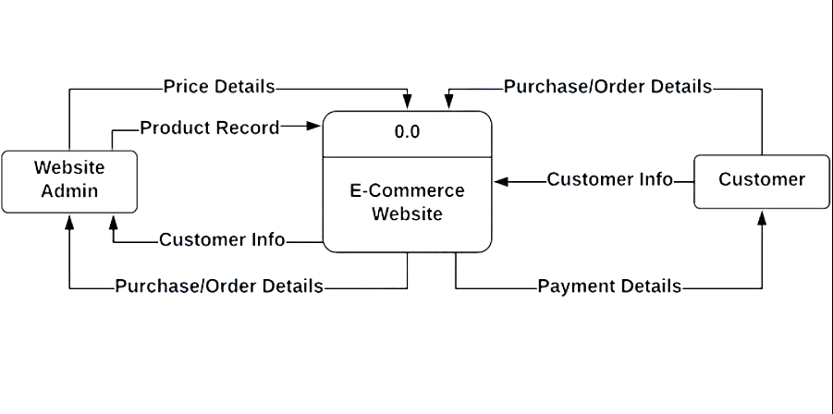
DATA FLOW DIAGRAM

Slide 8

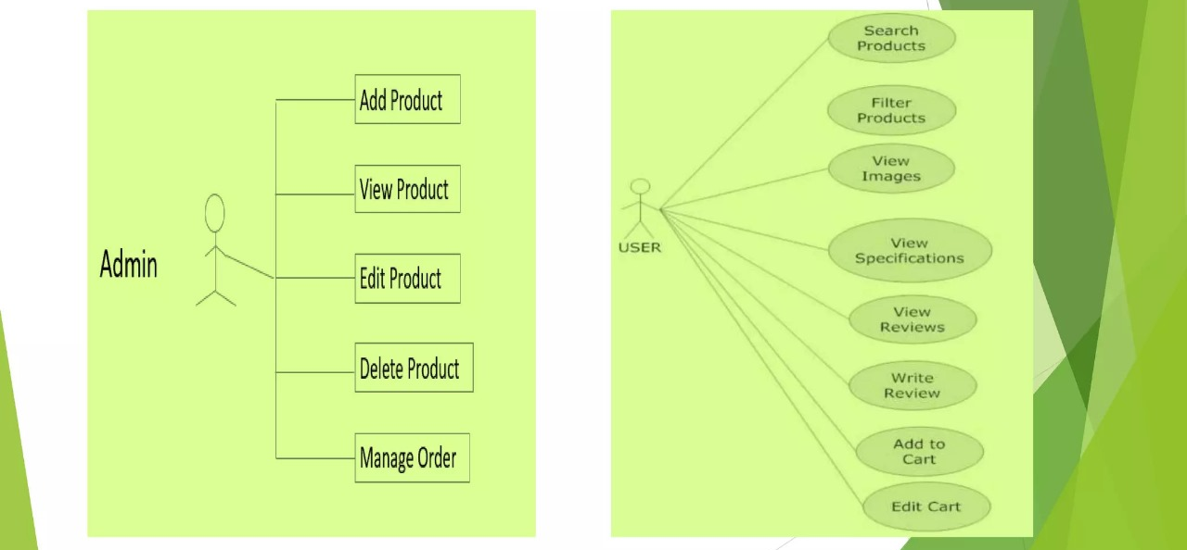
USER AND ADMIN CASE DIAGRAM

Slide 9
ADVANTAGES OF E-COMMERCE
Faster buying/selling procedure, as well as easy to find products.
Buying/selling 24/7.
More reach to customers, there is no theoretical geographic limitations.
Low operational costs and better quality of services.
No need of physical company set-ups.
Easy to start and manage a business.

Slide 10
FUTURE PLANS
We are thinking of some modifications and adding some advanced new features in out system. Some of them are -
GUI modification (more user friendly).
Users can sell their products.
Users can signup / login using their social media account such as Facebook , Google etc.

Slide 11
Thank You !

